Slide 1
Chapter 4: Patterns and Styles in
Software Architecture
Session II: Data-Centered, Data-Flow, and Distributed Systems

Slide 2
Session’s Agenda
Data-Centered Systems
  Overview
  Patterns
    Blackboard
Data Flow Systems
  Overview
  Patterns
    Pipes-and-Filters
Distributed Systems
  Overview
  Patterns
    Client Server
What’s next…
  Distributed systems – Broker Pattern
  Interactive Systems
  Hierarchical Systems

Slide 3
Data-Centered Systems
Data-centered systems are systems primarily decomposed around a main central repository of data. These include:
  Data management component
    The data management component controls, provides, and manages access to the system’s data.
  Worker components
    Worker components execute operations and perform work based on the data.
Communication in data-centered systems is characterized by a one-to-one bidirectional communication between a worker component and the data management component.
  Worker components do not interact with each other directly; all communication goes through the data management component.
Worker 1
Two way communication
Worker 2
Data Manager
Data repository
Manages data

Slide 4
Data-Centered Systems
Because of the architecture of these systems, they must consider issues with:
  Data integrity
  Communication protocols between worker and data management
  Transactions and recovery (also known as roll-back)
  Security
A common architectural pattern for data-centered systems is the Blackboard Pattern.
Worker 1
Worker 2
Communication Protocol
Security
Communication Protocol
Security
Data Manager
Transactions and Recovery
Security
Data Integrity

Slide 5
Blackboard Architectural Pattern
Blackboard decomposes systems into components that work around a central data component to provide solutions to complex problems.
  These components work independently from each other to provide partial solutions to problems using an opportunistic problem-solving approach.
  That is, there are no predetermined, or correct, sequences of operations for reaching the problem’s solution.
The Blackboard architectural pattern resembles the approach a group of scientists would employ to solve a complex problem.
  Consider a group of scientists at one location using a blackboard (chalkboard, whiteboard, or electronic blackboard) to solve a complex problem.
  Assume that to manage the problem-solving process, a mediator controls access to the blackboard.
  Once the mediator (or controller) assigns control to the blackboard, a scientist evaluates the current state of the problem and if possible, advances its solution before releasing control of the blackboard.
  With new knowledge obtained from the previous solution attempt, control is assigned to the next scientist who can further improve the problems’ state.
  This process continues until no more progress can be made, at which point the blackboard system reaches a solution.
This behavior is prevalent in expert systems, therefore, the Blackboard architectural pattern is a good choice for depicting the logical architecture of expert systems.

Slide 6

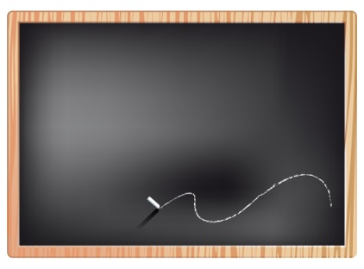




Blackboard Architectural Pattern
Agents cannot access blackboard until access is granted by controller.
The actual blackboard. In this example, this is the data repository
Controller
Agent 4 waits for his turn
Agent 3 waits for his turn
Agent 1
Access to the blackboard has been granted to Agent 1
Agent 2 waits for his turn
Agent 1 advances the solution!

Slide 7
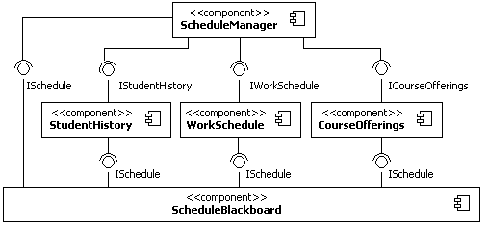
Blackboard Architectural Pattern
Consider the Students’ Scheduling System from Chapter 4.
Controller
Agents
Blackboard

Slide 8
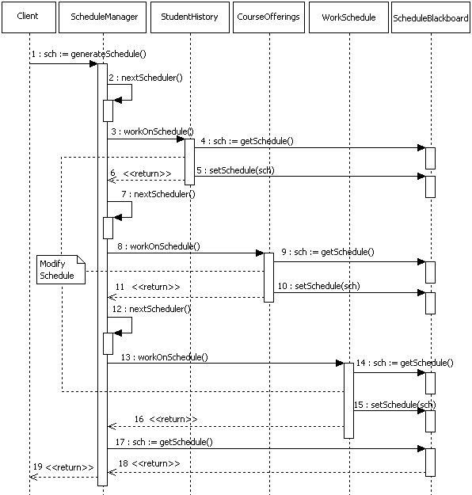
Blackboard Architectural Pattern
Client requests a schedule
Controller grants schedule access to the StudentHistory agent
The StudentHistory agent retrieves the data
The StudentHistory agent modifies the schedule and stores the results back
Controller grants schedule access to the CourseOfferings agent
This note provides important information!
The CourseOfferings agent retrieves, modifies, and stores the schedule back
Controller grants schedule access to the WorkSchedule agent
Client receives an optimized schedule

Slide 9
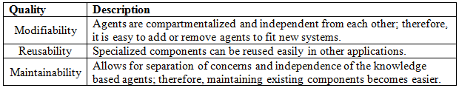
Blackboard Architectural Pattern
Quality properties of the Blackboard architectural pattern include the ones specified below.
An important aspect of the Blackboard and any other architectural pattern is their deployment aspect (i.e., the deployment view). For example, It is not easily determined from the logical view where each agent or blackboard component reside.
  Depending on their location, Blackboard can have increased complexity when managing communication between agents, controller, and blackboard.

Slide 10
Data Flow Systems
Data flow systems are decomposed around the central theme of transporting data (or data streams) and transforming the data along the way to meet application-specific requirements.
  Typical responsibilities found in components of data-flow systems include:
    Worker components, those that perform work on data
    Transport components, those that transporting data
Worker components abstract data transformations and processing that need to take place before forwarding data streams in the system, e.g.,
  Encryption and decryption
  Compression and decompression
  Changing data format, e.g. ,from binary to XML, from raw data to information, etc.
  Enhancing, modifying, storing, etc. of the data
Transport components abstract the management and control of the data transport mechanisms, which could include:
  Inter-process communication
    Sockets, serial, pipes, etc.
  Intra-process communication
    Direct function call, etc.
An example of an architectural pattern for data flow systems is the Pipes-and-Filters.

Slide 11
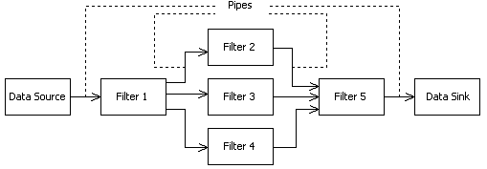
Pipes-and-Filters Architectural Pattern
Pipes-and-Filters is composed of the following components:
  Data source
    Produces the data
  Filter
    Processes, enhances, modifies, etc. the data
  Pipes
    Provide connections between data source and filter, filter to filter, and filter to data sink.
  Data Sink
    Data consumer
Not an UML diagram!
Data is moved and processed along the way until it reaches its destination, the Data Sink.
Pipes used to move the data!
Data source produces the data
Important:
The abstractions used in the box-and-line diagram above for Pipes can be deceiving, since they really do not convey the real identity of these mechanisms!
Filters work on the data!

Slide 12
Pipes-and-Filters Architectural Pattern
A common example for the Pipes-and-Filters pattern:
  Architecture of a Language Processor (e.g., compiler, interpreter)
Important:
Not a UML Diagram!
Lexical Analyzer
Parser
Code Generator
Optimizer
Lexical analyzer produces tokens
Parser produces parse trees
Generates code, e.g., machine language
Optimizes code
Reused component
It would be cool to build an interpreter… I know, let’s reuse the components that we already have!
Lexical Analyzer
Parser
Optimizer
Interpreter
Lexical analyzer produces tokens
Parser produces parse trees
Optimizes interpreted form of the program
Run the program

Slide 13
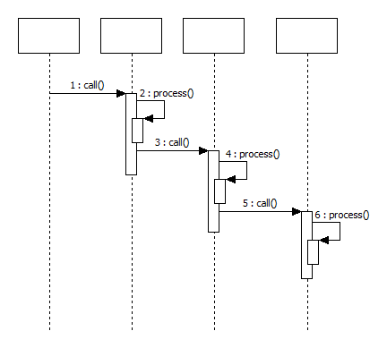
Pipes-and-Filters Architectural Pattern
Filters
Important:
A UML Diagram!
Lexical Analyzer
Parser
Code Generator
Optimizer
In this example, the Pipes are simply function calls!

Slide 14
Pipes-and-Filters Architectural Pattern
Consider software that houses algorithms for automatically determining the identity of an individual:
  The software access videos (with audio) from You Tube
  The software detects faces of individuals in the video
    Face detection is used to determine if a face is in the video
  The software recognizes faces speech from the video
    Face recognition is used to determine the identity of the person from the detected face.
  Based on detection and recognition, the software predicts the identity of individuals in the video
Using the pipes and filters architecture, the logical structure of the system can be modeled as follows:
Important:
Consider what would happen if a better algorithm for recognition is discovered?
Big video file!
Transformed data containing only the information from detected faces!
Transformed data containing only the results from the recognition process, e.g., a report of identity!
Wanted!
Youtube Manager
Face Detection
Face Recognition
Identity Manager
Joe Developer
Wanted!

Slide 15
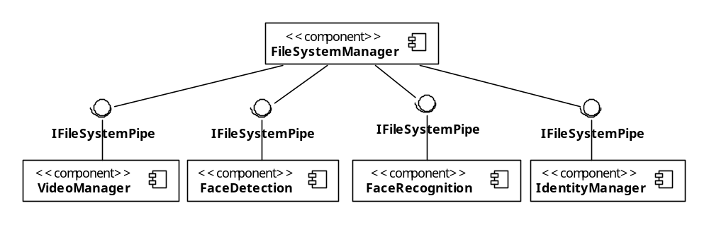
Pipes-and-Filters Architectural Pattern
In the previous example, the box-and-line diagram was useful for visualizing the components in the system, however, it conveyed nothing about how data is transported from one Filter to the next, i.e., the Pipes.
  Consider the following UML component for the same system
This component may reuse existing mechanisms to facilitate data movement, for example, the .NET FileSystemWatcher.
In this system, data is moved through the File System using a mechanism that relies on monitoring of new files!
This interface encapsulates the FileSystemWatcher and provides other services for creating, deleting, reading and writing files.
Warning:
This is not the typical example that you would find for Pipes-and-Filters. However, it displays the inherent flexibility present when employing architectural patterns.
These components require monitoring of directories from the File System Manager. When a new file is detected, the File System Manger fires an event, indicating that a new file has been received, which triggers some processing by the Filter components.

Slide 16
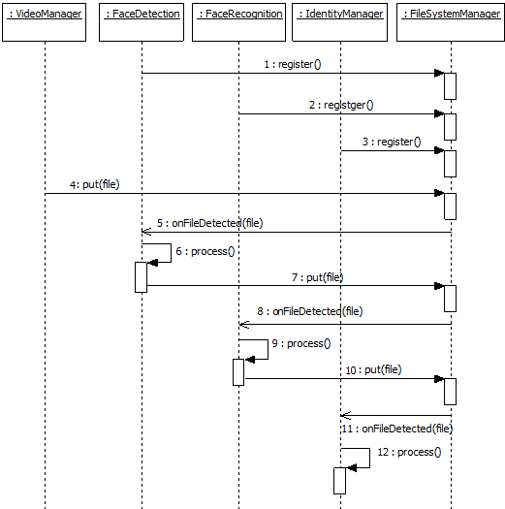
A more detailed example of the message exchanges in the example
: VideoManager
: FaceDetection
: FaceRecognition
: IdentityManager
: FileSystemManager
Register with the file system manager
Youtube video file found! Transport the file to the next component via the file system.
This triggers and event!
Notify anyone registered for monitoring of this directory
Do work using the data from the file, save the results on the file system so that the process can repeat again with the next component / filter.
Identity determined!

Slide 17
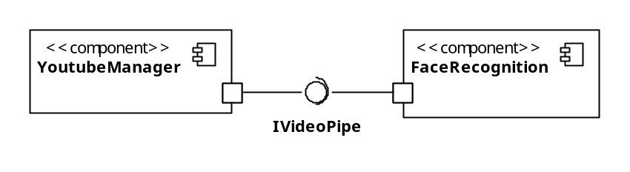
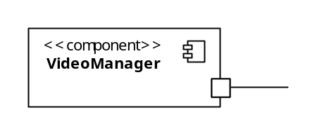
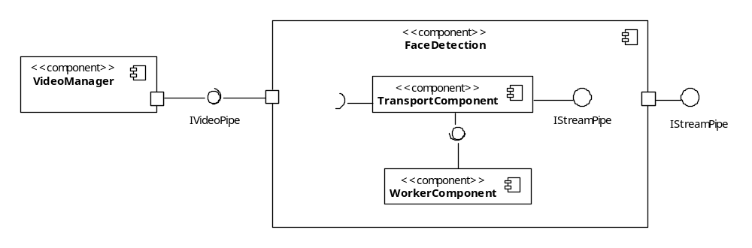
Assume now that unlike the previous example, the Video component now interfaces with a camera for real-time video feed!
Consider the Pipes-and-Filters modeled this way
Other Pipes and Filters in the System
Filter Component
Pipe Interface
Filter Component
When modeled this way, there are implications about the internal structure of these components!
For example, see below
Similarly, since Pipes-and-Filters specify the separation between pipes and filters, there is an implication about the existence of both pipe and Filter component inside the Video Manager
Provided interface to transport the data stream to the next component
<<delegate>>
<<delegate>>
Pipe
Filter

Slide 18
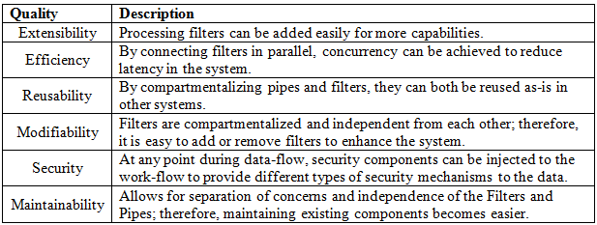
Pipes-and-Filters Architectural Pattern
Quality properties of the Pipes-and-Filters architectural pattern include the ones specified below.

Slide 19
Distributed Systems
Distributed systems are decomposed into multiple processes that (typically) collaborate through the network.
  These systems are ubiquitous in today’s modern systems thanks to wireless, mobile, and internet technology.
    In some distributed systems, one or more distributed processes perform work on behalf of client users and provide a bridge to some server computer, typically located remotely and performing work delegated to it by the client part of the system.
    Other distributed systems may be composed of peer nodes, each with similar capabilities and collaborating together to provide enhanced services, such as music-sharing distributed applications.
  These types of distributed systems are easy to spot, since their deployment architecture entails multiple physical nodes.
  However, with the advent of multi-core processors, distributed architectures are also relevant to software that executes on a single node with multiprocessor capability.
Some examples of distributed systems include:
  Internet systems, web services, file- or music-sharing systems, high-performance systems, etc.
Common architectural patterns for distributed systems include:
  Client-Server Pattern
  Broker Pattern

Slide 20
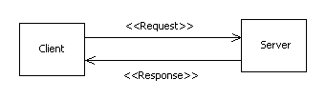
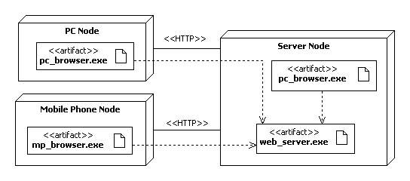
Client-Server Pattern

Slide 21
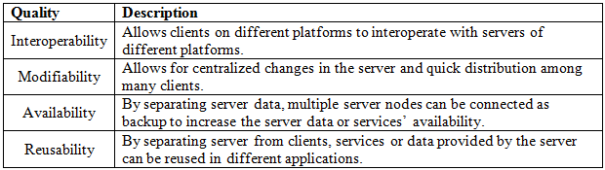
Client-Server Pattern
Quality properties of the Client-Server architectural pattern include the ones specified below.

Slide 22
What’s Next…
In this session, we presented fundamentals concepts of data-centered , data flow, and distributed systems, together with essential architectural patterns for these systems, including:
  Blackboard
  Pipes-and-Filters
  Client-server
In the next session, we will continue the discussion of distributed systems and present in depth two other types of systems (i.e., Interactive and Hierarchical) together with architectural patterns, including:
  Model-View-Controller
  Layered
  Main program and subroutine

